Slide 1
Chapter 4
Database Management Systems

Slide 2
Outline
How do you store and retrieve the vast amount of data collected in a modern company?
Why is the database management approach so important to business?
How do you write questions for the DBMS to obtain data?
How do you create a new database?
How do you create business applications using a DBMS?
What tasks need to be performed to keep a database running?
Why are databases so important in e-business?
How are databases used in cloud computing?

Slide 3
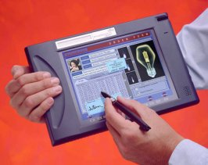

Database Management Systems
Reports and
ad hoc queries
Database
DBMS
Programs
Sales and transaction data

Slide 4


Central Role of DBMS
Database Administrator
Programmer
Analyst
(Standards, Design, and Control)
Data
Programs
Database
Management
System
& Revisions
Ad Hoc Queries
and Reports
Managers
Program
Program
Business Needs
Data Collection
and Transaction
Processing
Business Operations

Slide 5
Relational Databases
Tables
Rows
Columns
Primary keys
Data types
Text
Dates & times
Numbers
Objects
Customer Table
CustomerID | Name | Address | City
12345 | Jones | 125 Elm | Chicago
28764 | Adamz | 938 Main | Phoenix
29587 | Smitz | 523 Oak | Seattle
33352 | Sanchez | 999 Pine | Denver
44453 | Kolke | 909 West | Denver
87535 | James | 374 Main | Miami
Sales Table
SaleID | CustomerID | Date | Salesperson
117 | 12345 | 3/3/12 | 887
125 | 87535 | 4/4/12 | 663
157 | 12345 | 4/9/12 | 554
169 | 29587 | 5/6/12 | 255

Slide 6
Database Advantages
Focus on data
Stable data
Programs change.
Data independence
Change programs without altering data.
Data integrity
Accuracy.
Time.
Concurrency.
Security.
Ad hoc queries
Speed of development
Report writers.
Input forms.
Data manipulation.
Flexibility & Queries
All Data Files
Database Management
System
Invoice
Program
Billing
Program

Slide 7
Data Quality: Concurrent Access
Transaction A | Customer Accounts Sanchez: Balance | Transaction B
1) Receive 300 payment 2) Read Balance (500) | Sanchez: 500
 |  | 3) New Purchase (350) 4) Read Balance (500)
5) Subtract payment 6) Store new results (200) | Sanchez: 200
 | Sanchez: 850 | 7) Add purchase 8) Store new result (850)

Slide 8
Database Queries
Four questions to create a query
1) What output do you want to see?
2) What do you already know? (constraints)
3) What tables are involved?
4) How are the tables joined?
Single Table
Computations
Joining Tables

Slide 9
Sample Data: Customers
CustomerID | Name | Phone | City | AccountBalance
12345 | Jones | 312-555-1234 | Chicago | 197.54
28764 | Adamz | 602-999-2539 | Phoenix | 526.76
29587 | Smitz | 206-676-7763 | Seattle | 353.76
33352 | Sanchez | 303-444-1352 | Denver | 153.00
44453 | Kolke | 303-888-8876 | Denver | 863.39
87535 | James | 305-777-2235 | Miami | 255.93

Slide 10
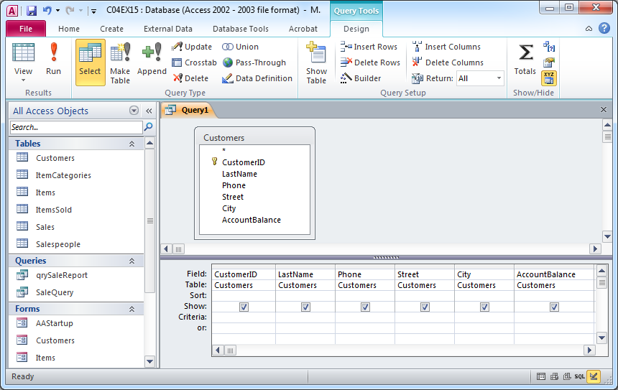
Single Table Query Introduction
File: C04E15.mdb
Access Query Screen (grid)
Query: List all of the customers.

Slide 11
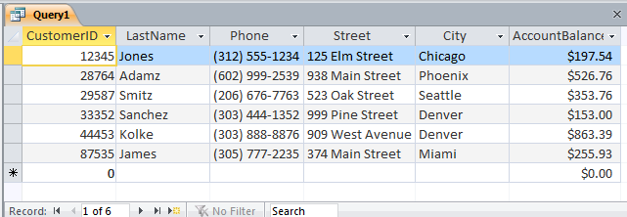
Results: Customer Query

Slide 12
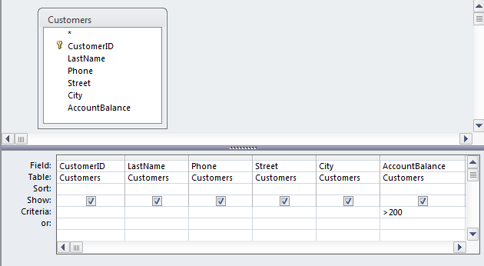
Query Conditions
Which customers owe more than $200?

Slide 13
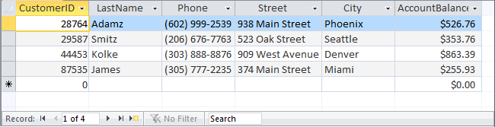
Query Results

Slide 14
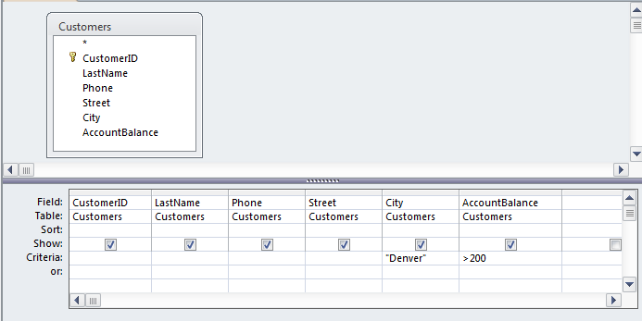
Query: AND
Which customers from Denver owe more than $200?

Slide 15
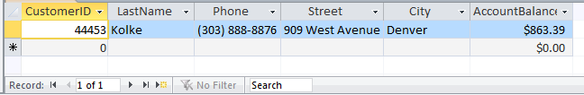
Query Results

Slide 16
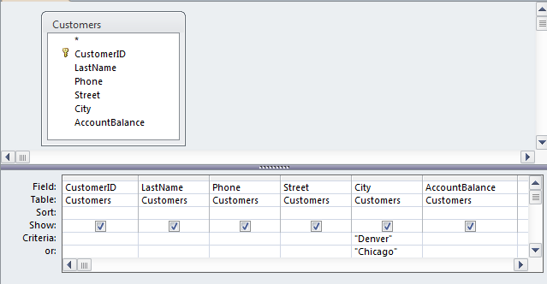
Query: OR
List customers from Denver or Chicago.

Slide 17
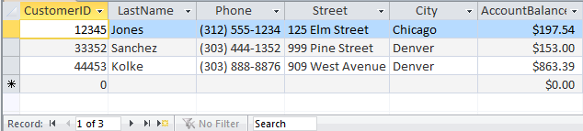
Query Results

Slide 18
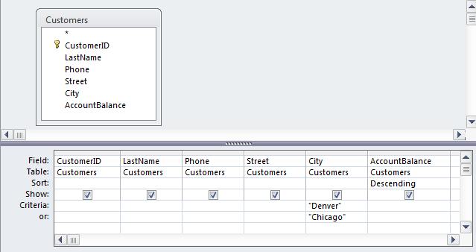
Query: Sorting
List customers from Denver or Chicago, sort the results.

Slide 19
SQL General Form
SELECT columns
FROM tables
JOIN link columns
WHERE conditions
GROUP BY column
ORDER BY column (ASC | DESC)

Slide 20
SQL Introduction
List all customers.
SQL: SELECT *
FROM Customers

Slide 21
SQL: AND Condition
SELECT Name, Phone, City, AccountBalance
FROM Customers
WHERE (AccountBalance>200) AND (City=”Denver”)

Slide 22
SQL: OR Condition
SELECT Customers.CustomerID, Customers.Name, Customers.Phone,
Customers.City, Customers.AccountBalance
FROM Customers
WHERE (Customers.City = "Denver")
OR (Customers.City = "Chicago")

Slide 23
Common Query Conditions
Operator | Meaning | Examples
= | Equals | City=’Denver’ Salary=60000
< > | Less than Greater than | Salary < 60000 Sales > 15000
< > | Not equal | City <> ‘Denver’
BETWEEN | Between x and y | SaleDate BETWEEN ‘01-Jan-2012’ AND ‘28-Feb-2012’ Sales BETWEEN 10000 AND 20000
LIKE | Simple pattern matching % or * matches any characters _ or ? matches one | LastName LIKE ‘J%’ ProductID LIKE ‘BL_ _DR _ _ _’
Null | Missing data | City Is Null
NOT | Negation | Not City=’Denver’

Slide 24
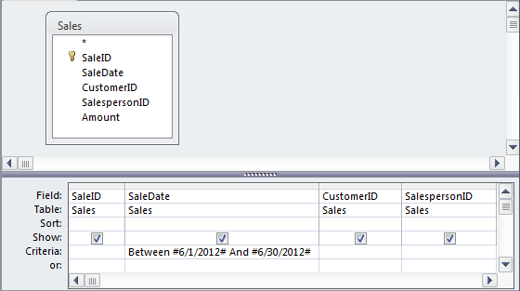
Conditions: BETWEEN
List sales in June.
Commonly used for date conditions:
WHERE SaleDate BETWEEN ‘6/1/2012’ AND ‘6/30/2012’

Slide 25
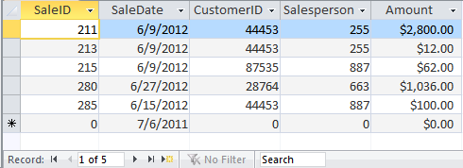
Query Results

Slide 26
Standard Aggregation Functions
SUM total value of items AVG average of values MIN minimum value MAX maximum value COUNT number of rows STDEV standard deviation VAR variance of items

Slide 27
Sample Data: Sales Amount
Amount
$197.54
$526.76
$353.76
$153.00
$863.39
$255.93

Slide 28
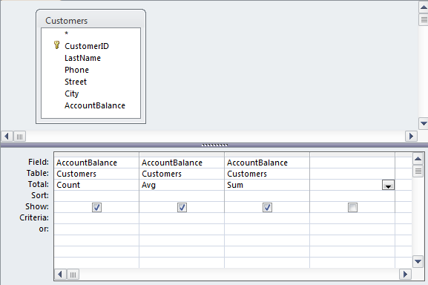
Query: Aggregation
Count | Avg | Sum
6 | $391.73 | $2,350.38

Slide 29
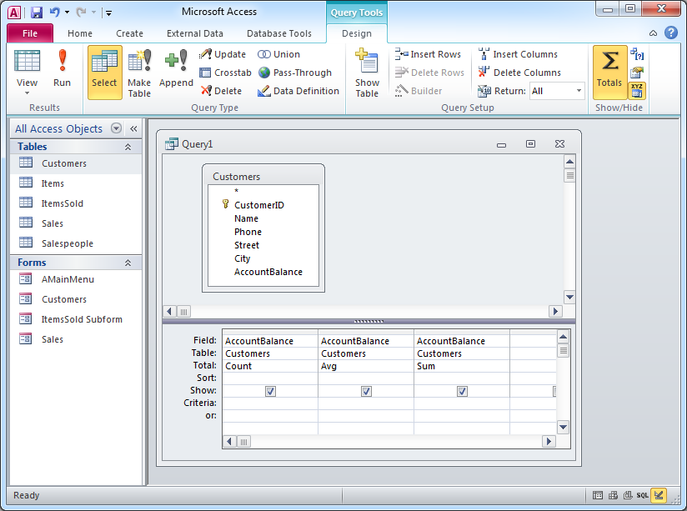
Aggregation Query in Access Grid
Click Totals Button
Totals Row

Slide 30
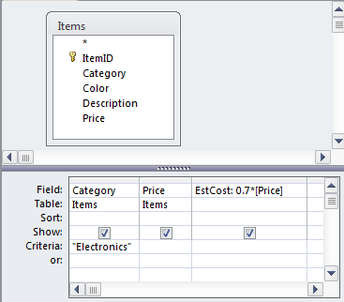
Row-by-Row Computations
Type formula
Then change row heading
Category | Price | EstCost
Electronics | $1,000.00 | 700
Electronics | $50.00 | 35

Slide 31
SQL: Aggregation
How many customers are there and want is the average balance?
SELECT Count(CustomerID) AS NCustomers,
Avg(AccountBalance) AS AverageOwed
FROM Customers

Slide 32
SQL: Row-by-Row Calculations
Estimate the cost of clothing items as 70 percent of the price.
SELECT Category, Price, 0.7*Price AS EstCost
FROM Items
WHERE (Category=”Electronics”)

Slide 33
Subtotals: SQL
How much money is owed by customers in each city?
SELECT City, Sum(AccountBalance) AS SumOfAccountBalance
FROM Customers
GROUP BY City
City | SumOfAccountBalance
Chicago | $197.54
Denver | $1,016.39
Miami | $255.93
Phoenix | $526.76
Seattle | $353.76

Slide 34
Multiple Tables
Customers
Sales
CID LastName Phone City AccountBalance
12345 Jones 312-555-1234 Chicago $197.54
28764 Adamz 602-999-2539 Phoenix $526.76
Smitz 206-656-7763 Seattle $353.76
33352 Sanchez 303-444-1352 Denver $153.00
44453 Kolke 303-888-8876 Denver $863.39
87535 James 305-777-2235 Miami $255.98
SaleID CID SPID SaleDate
117 12345 887 3/3/2012
125 87535 663 4/4/2012
157 12345 554 4/9/2012
169 29587 255 5/5/2012
178 44453 663 5/1/2012
188 29587 554 5/8/2012
201 12345 887 5/28/2012
211 44453 255 6/9/2012
213 44453 255 6/10/2012
215 87535 887 6/9/2012
28764 663 5/27/2012
285 28764 887 6/15/2012
Salespeople
SPID LastName DateHired Phone Commission
255 West 5/23/05 213-333-2345 5
452 Thomas 8/15/04 213-343-5553 3
554 Jabbar 7/15/01 213-534-8876 4
663 Bird 9/12/03 213-225-3335 4
887 Johnson 2/2/02 213-887-6635 4
ItemsSold
SaleID ItemID Quantity
117 1154 2
117 3342 1
117 7653 4
125 1154 4
125 8763 3
157 7653 2
169 3342 1
169 9987 5
178 2254 1
Items
ItemID Category Description Price
1154 Shoes Red Boots $100.00
2254 Clothes Blue Jeans $12.00
3342 Electronics LCD-40 inch $1,000.00
7653 Shoes Blue Suede $50.00
8763 Clothes Mens’ Work Boots $45.00
9987 Electronics Blu-Ray Player $400.00

Slide 35
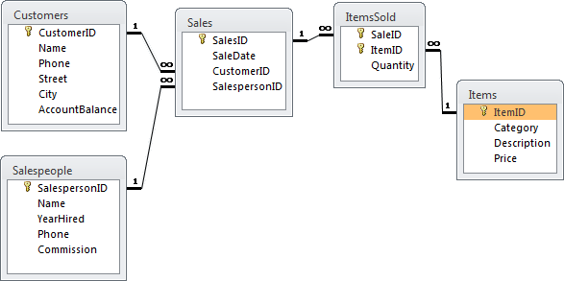
Linking Tables
The Sales to ItemsSold relationship enforces referential integrity.
One Sale can list many ItemsSold.

Slide 36
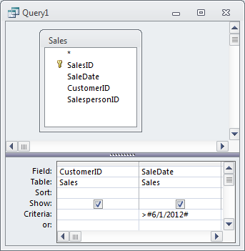
Query Example
Which customers (CustomerID) have placed orders since June 1, 2012?
SQL
QBE
SELECT CustomerID, SaleDate
FROM Sales
WHERE SaleDate >= #6/1/2012# ;
Results
CustomerID SaleDate
44453 6/9/2012
44453 6/10/2012
87535 6/9/2012
28764 6/15/2012

Slide 37
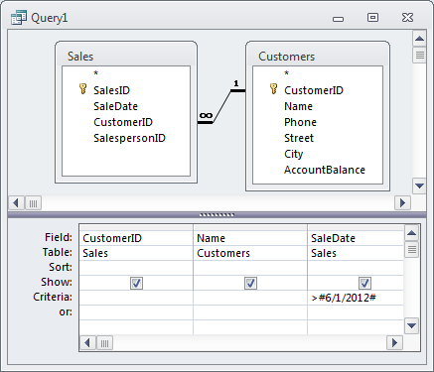
Query Example
What are the names of the customers who placed orders since June 1, 2012?
SQL
SELECT DISTINCT Customers.CustomerID, Name, SaleDate
FROM Sales
INNER JOIN Customers
ON Sales.CustomerID = Customers.CustomerID
WHERE SaleDate >= #6/1/2012# ;
Grid
Results
CustomerID Name OrderDate
28764 Adamz 6/15/2012
44453 Kolke 6/9/2012
44453 Kolke 6/10/2012
87535 James 6/9/2012

Slide 38
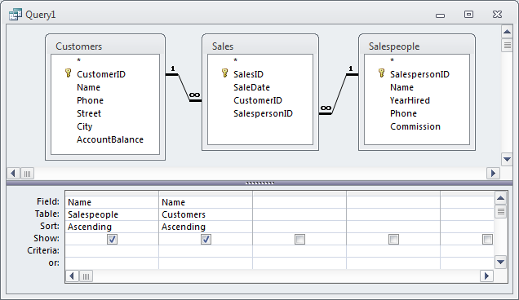
Query Example
List the salespeople (sorted alphabetically) along with the names of customers who placed orders with that salesperson.
SQL
SELECT DISTINCT Salespeople.Name, Customers.Name
FROM Salespeople
INNER JOIN (Customers INNER JOIN Orders ON
Customers.CustomerID=Sales.CustomerID)
ON Salespeople.SalespersonID = Sales.SalespersonID
ORDER BY Salespeople.Name, Customers.Name ;
Results
SalesName Cust.Name
Bird Adamz
Bird James
Bird Kolke
Jabbar Jones
Jabbar Smitz
Johnson Adamz
Johnson James
Johnson Jones
West Kolke
West Smitz
QBE

Slide 39
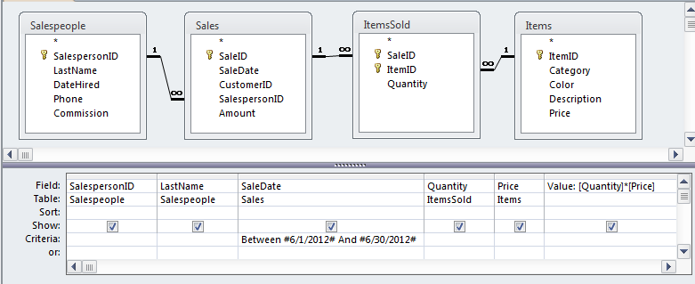
Multiple Tables, GROUP BY, WHERE
Who are the top salespeople in June?
Begin by listing the sales in June.

Slide 40
Sales Rows
SalespersonID | Name | SaleDate | Quantity | Price | Value
255 | West | 6/9/2012 | 2 | $1,000.00 | $2,000.00
255 | West | 6/9/2012 | 5 | $50.00 | $250.00
255 | West | 6/9/2012 | 1 | $12.00 | $12.00
887 | Johnson | 6/9/2012 | 1 | $12.00 | $12.00
887 | Johnson | 6/9/2012 | 1 | $50.00 | $50.00
The quantity and price columns are shown temporarily to ensure the computation is specified correctly for the Value column.

Slide 41
Subtotal in SQL
SELECT Salespeople.SalespersonID, Salespeople.Name, Sum([Quantity]*[Price]) AS [Value]
FROM Items INNER JOIN ((Salespeople
INNER JOIN Sales
ON Salespeople.SalespersonID = Sales.SalespersonID)
INNER JOIN ItemsSold
ON Sales.SalesID = ItemsSold.SaleID)
ON Items.ItemID = ItemsSold.ItemID
WHERE (Sales.SaleDate Between #6/1/2012# And #6/30/2012#)
GROUP BY Salespeople.SalespersonID, Salespeople.Name
ORDER BY Sum([Quantity]*[Price]) DESC;

Slide 42
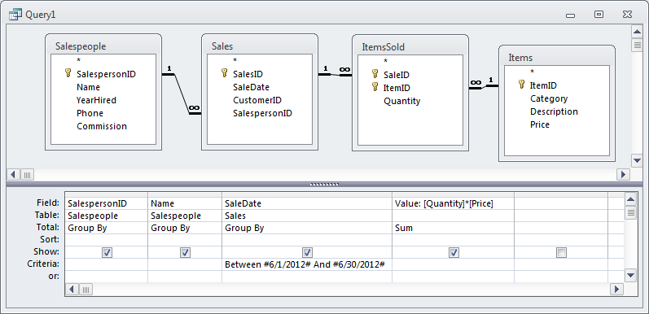
Subtotals: Access Grid First Attempt
Who are the top salespeople in June?
Set the totals and set the Sum column.
Incomplete. See results…

Slide 43
Initial Results
SalespersonID | Name | SaleDate | Value
255 | West | 6/9/2012 | $2,250.00
255 | West | 6/10/2012 | $12.00
887 | Johnson | 6/9/2012 | $62.00
Salesperson #255 (West) shows up multiple times because of multiple days. GROUP BY Day, Salesperson

Slide 44
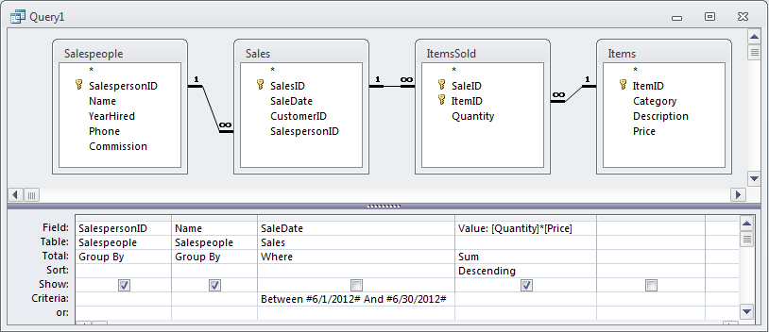
GROUP BY Conditions: WHERE
Use WHERE instead of GROUP BY

Slide 45
Best Salesperson Results
SalespersonID | Name | Value
255 | West | $2,262.00
887 | Johnson | $62.00

Slide 46
Converting Business Questions to Queries
What do you want to see?
What constraints are you given?
What tables are involved?
How are the tables joined?
SELECT
FROM
INNER JOIN
WHERE
GROUP BY
ORDER BY
Start with the parts you know how to do.
Verify the results at each step.
Add more tables and columns as needed
Do aggregate totals at the end—after verifying the rows.
Look for “for each” or “by” to use GROUP BY for subtotals.

Slide 47
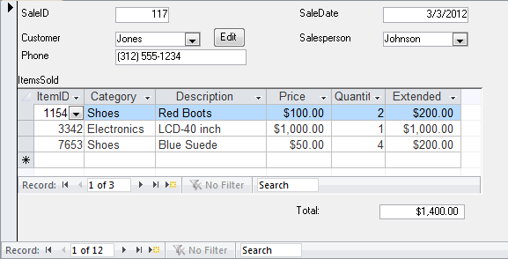
Database Design: Normalization

Slide 48
Notation
Table name
Table columns
Customer (CustomerID, LastName, Phone, Street, City, AccountBalance)
CustomerID | Last Name | Phone | Street | City | AccountBalance
12345 | Jones | (312) 555-1234 | 125 Elm Street | Chicago | $197.54
28764 | Adamz | (602) 999-2539 | 938 Main Street | Phoenix | $526.76
29587 | Smitz | (206) 676-7763 | 523 Oak Street | Seattle | $353.76
33352 | Sanchez | (303) 444-1352 | 999 Pine Street | Denver | $153.00
44453 | Kolke | (303) 888-8876 | 909 West Avenue | Denver | $863.39
87535 | James | (305) 777-2235 | 374 Main Street | Miami | $255.93

Slide 49
1st: Repeating
SaleForm(SaleID, SaleDate, CustomerID, Phone, Name, Street, (ItemID, Quantity, Description, Price ) )
Repeating Section
Causes duplication
SaleID | SaleDate | CustomerID | Name | Phone | Street | ItemID | Quantity | Description | Price
117 | 3/3/2012 | 12345 | Jones | (312) 555-1234 | 125 Elm Street | 1154 | 2 | Red Boots | $100.00
117 | 3/3/2012 | 12345 | Jones | (312) 555-1234 | 125 Elm Street | 3342 | 1 | LCD-40 inch | $1,000.00
117 | 3/3/2012 | 12345 | Jones | (312) 555-1234 | 125 Elm Street | 7653 | 4 | Blue Suede | $50.00
125 | 4/4/2012 | 87535 | James | (305) 777-2235 | 374 Main Street | 1154 | 4 | Red Boots | $100.00
125 | 4/4/2012 | 87535 | James | (305) 777-2235 | 374 Main Street | 8763 | 3 | Men's Work Boots | $45.00
157 | 4/9/2012 | 12345 | Jones | (312) 555-1234 | 125 Elm Street | 7653 | 2 | Blue Suede | $50.00
169 | 5/6/2012 | 29587 | Smitz | (206) 676-7763 | 523 Oak Street | 3342 | 1 | LCD-40 inch | $1,000.00
169 | 5/6/2012 | 29587 | Smitz | (206) 676-7763 | 523 Oak Street | 9987 | 2 | Blu-Ray Player | $400.00
178 | 5/1/2012 | 44453 | Kolke | (303) 888-8876 | 909 West Avenue | 2254 | 1 | Blue Jeans | $12.00
188 | 5/8/2012 | 29587 | Smitz | (206) 676-7763 | 523 Oak Street | 3342 | 1 | LCD-40 inch | $1,000.00
188 | 5/8/2012 | 29587 | Smitz | (206) 676-7763 | 523 Oak Street | 8763 | 4 | Men's Work Boots | $45.00
201 | 5/23/2012 | 12345 | Jones | (312) 555-1234 | 125 Elm Street | 1154 | 1 | Red Boots | $100.00

Slide 50
First Normal
SalesForm with repeating data
SaleID | SaleDate | CustomerID | Name | Phone | Street | ItemID, Quantity, Description, Price
117 | 3/3/2012 | 12345 | Jones | (312) 555-1234 | 125 Elm Street | 1154, 2, Red Boots, $100.00 3342, 1, LCD-40 inch, $1,000.00 7653, 4, Blue Suede, $50.00
125 | 4/4/2012 | 87535 | James | (305) 777-2235 | 374 Main Street | 1154, 4, Red Boots, $100,00 8763, 3, Men’s Work Boots, $45.00
157 | 4/9/2012 | 12345 | Jones | (312) 555-1234 | 125 Elm Street | 7653, 2, Blue Suede, $50.00
169 | 5/6/2012 | 29587 | Smitz | (206) 676-7763 | 523 Oak Street | 3342, 1, LCD-40 inch, $1,000.00 9987, 2, Blu-Ray Player, $400.00
178 | 5/1/2012 | 44453 | Kolke | (303) 888-8876 | 909 West Avenue | 2254, 1, Blue Jeans, $12.00
188 | 5/8/2012 | 29587 | Smitz | (206) 676-7763 | 523 Oak Street | 3342, 1, LCD-40 inch, $1,000.00 8763, 1, Men’s Work Boots, $45.00
201 | 5/23/2012 | 12345 | Jones | (312) 555-1234 | 125 Elm Street | 1154, 1, Red Boots, $100.00
Not in First Normal Form

Slide 51
1st: Split
SaleForm(SaleID, SaleDate, CustomerID, Phone, Name, Street, (ItemID, Quantity, Description, Price ) )
SaleForm2(SaleID, SaleDate, CustomerID, Phone, Name, Street)
SaleID | SaleDate | CustomerID | Name | Phone | Street
117 | 3/3/2012 | 12345 | Jones | (312) 555-1234 | 125 Elm Street
117 | 3/3/2012 | 12345 | Jones | (312) 555-1234 | 125 Elm Street
117 | 3/3/2012 | 12345 | Jones | (312) 555-1234 | 125 Elm Street
125 | 4/4/2012 | 87535 | James | (305) 777-2235 | 374 Main Street
125 | 4/4/2012 | 87535 | James | (305) 777-2235 | 374 Main Street
SaleLine(SaleID, ItemID, Quantity, Description, Price)
SaleID | ItemID | Quantity | Description | Price
117 | 1154 | 2 | Red Boots | $100.00
117 | 3342 | 1 | LCD-40 inch | $1,000.00
117 | 7653 | 4 | Blue Suede | $50.00
125 | 1154 | 4 | Red Boots | $100.00
125 | 8763 | 3 | Men's Work Boots | $45.00
157 | 7653 | 2 | Blue Suede | $50.00
169 | 3342 | 1 | LCD-40 inch | $1,000.00
169 | 9987 | 2 | Blu-Ray Player | $400.00
178 | 2254 | 1 | Blue Jeans | $12.00
188 | 3342 | 1 | LCD-40 inch | $1,000.00
188 | 8763 | 4 | Men's Work Boots | $45.00
201 | 1154 | 1 | Red Boots | $100.00
Note: replication
Note: replication

Slide 52
2nd Split
Column depends on entire (whole) key.
SalelLine(SaleID, ItemID, Quantity, Description, Price)
ItemsSold(SaleID, ItemID, Quantity )
Items(ItemID, Description, Price)
SaleID | ItemID | Quantity
117 | 1154 | 2
117 | 3342 | 1
117 | 7653 | 4
125 | 1154 | 4
125 | 8763 | 3
157 | 7653 | 2
169 | 3342 | 1
169 | 9987 | 2
178 | 2254 | 1
188 | 3342 | 1
ItemID | Description | Price
1154 | Red Boots | $100.00
2254 | Blue Jeans | $12.00
3342 | LCD-40 inch | $1,000.00
7653 | Blue Suede | $50.00
8763 | Men's Work Boots | $45.00
9987 | Blu-Ray Player | $400.00

Slide 53
3rd Split
SaleForm2(SaleID, SaleDate, CustomerID, Phone, Name, Street)
Sales(SaleID, SaleDate, CustomerID )
SaleID | SaleDate | CustomerID | SalespersonID
117 | 3/3/2012 | 12345 | 887
125 | 4/4/2012 | 87535 | 663
157 | 4/9/2012 | 12345 | 554
169 | 5/6/2012 | 29587 | 255
178 | 5/1/2012 | 44453 | 663
188 | 5/8/2012 | 29587 | 554
Customers(CustomerID, Phone, Name, Address, City, State, ZipCode)
CustomerID | Name | Phone | Street | City | AccountBalance
12345 | Jones | (312) 555-1234 | 125 Elm Street | Chicago | $197.54
28764 | Adamz | (602) 999-2539 | 938 Main Street | Phoenix | $526.76
29587 | Smitz | (206) 676-7763 | 523 Oak Street | Seattle | $353.76
33352 | Sanchez | (303) 444-1352 | 999 Pine Street | Denver | $153.00
44453 | Kolke | (303) 888-8876 | 909 West Avenue | Denver | $863.39
87535 | James | (305) 777-2235 | 374 Main Street | Miami | $255.93

Slide 54
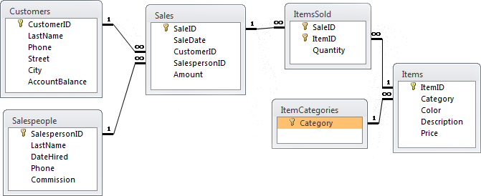
3NF Tables

Slide 55
DBMS Input Screen
Text/Labels
Data Variables
Command
Buttons
Record Selectors
- Subform
- Main
Scrolling Region/Subform

Slide 56
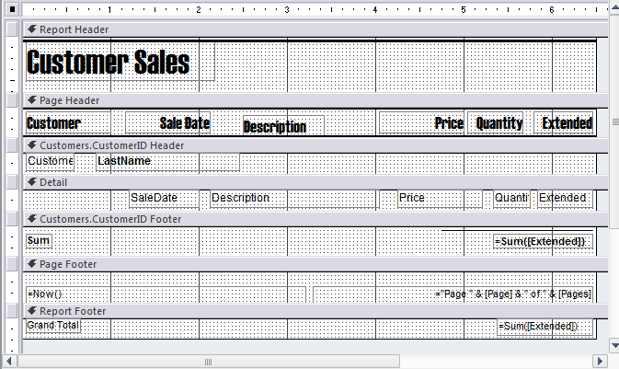
DBMS Report Writer
Report header
Page header
Break/Group header
Detail
Footers

Slide 57
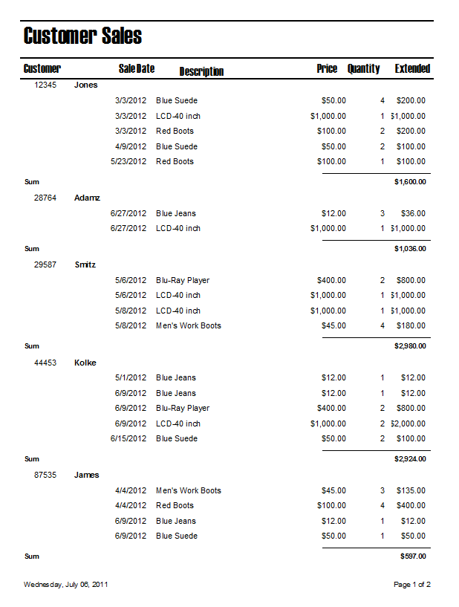
Sample Report with Groups

Slide 58
Designing Menus for Users
Main Menu
Customer Information
1. Setup Choices
2. Data Input
3. Print Reports
4. DOS Utilities
5. Backups
Daily Sales Reports
Friday Sales Meeting
Monthly Customer Letters
Quit
As a secretary, which menu is easier to understand?

Slide 59
Database Administration
Database Administrator
Testing
Backup
Recovery
Standards
Access Controls

Slide 60
E-Business Databases
E-business is transaction-based
Databases support multiple users and protect transactions
Modern websites are driven by databases

Slide 61

E-Business Databases
SQL
Results
Database Server
Web Server
Web program script
<HTML>
Text
Data
</HTML>
Order Form
Descriptions
Prices
Customer

Slide 62
Cloud Database Service Benefits
No fixed costs
No hardware or software
No maintenance
Easy administration
Pricing based on usage
Monthly data storage (size)
Monthly data transfer (usage)
Scalable
Multiple, distributed servers
Multiple, high-speed Internet connections
Reliable
Distributed
Run by experts
Security monitoring

Slide 63
Cloud Database Limits
Costs increase based on usage
At some point, it might be cheaper to buy and run everything yourself
Not pay profit/overhead to third-party
But be sure to measure all fixed costs

Slide 64
Cloud Database Pricing
Example: Amazon RDS (MySQL), U.S. East
1 Extra large instance
20 hours/day
20 GB/month at 50 million I/O per month
10 GB/month data transfer in
500 GB/month data transfer out
20 GB/month regional transfer
=> $616 per month ($7400/year)
All values are estimates and might not include all fees.
Example: Microsoft SQLAzure Business Edition
1 Extra large instance ($0.96/hour = $576/month)
20 GB/month ($200/month)
10 GB/month data transfer in ($1/month)
500 GB/month data transfer out ($75/month)
=> $852 per month ($10,224/year)
You get a relatively large database with T1-level data transfer for less than 10 percent of the cost of a DBA.

Slide 65
Cases: Pharmaceuticals

